Slide 1
Face Recognition using PCA
Design a classifier to recognize face image
Team Cortes
August 2017

Slide 2
Agenda
Abstract – problem statement
Data we collected
Approach
Data
PCA
Linear Classifier
Conclusion

Slide 3
Approach
Data Preparation: Collect face images using opencv package
Applied PCA – to reduce the dimensionality of the data while retaining as much information
Split the data into training and test data
Build classifier using training data set
Guassian, Linear Classifier
Test classifier using test data set
Measure classifier performance using Confusion Matrix

Slide 4
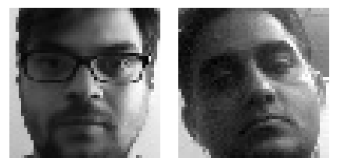
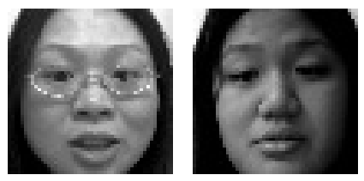
We created our own database!
We took 100 pictures of each one of us using opencv to create our own face database
Example of Face database

Slide 5
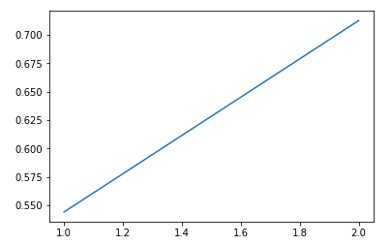
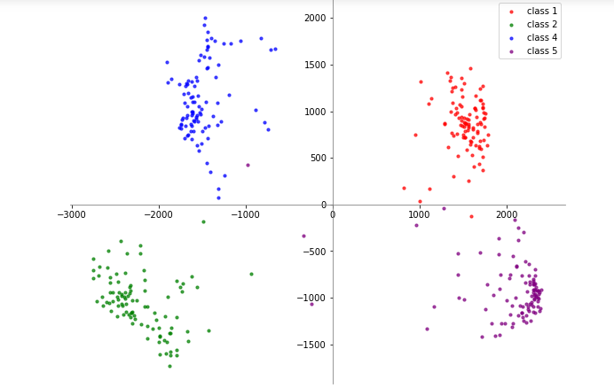
Plot shows class are very well separated – Linear Classifier a good fit
Eigen Values Graph
Nicolas/Weiya – Can you please replace this graph with higher values

Slide 6
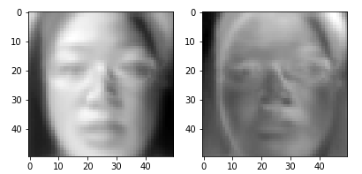
Eigen Faces
Nicolas/Weiya – Can we add more Eigen faces here, may be one for each of us?

Slide 7
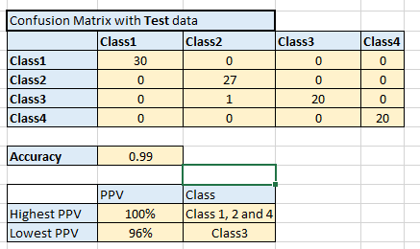
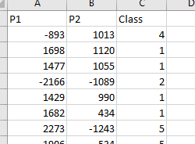
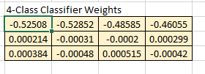
Linear Classifier
Re-class using Kesler’s construction
Find optimal set of weights $\left\{w_{0},w_{1},w_{2},…,w_{d}\right\} using W={Xa}^{+}T$
For the input form $xa W$ and assign class based on the position of the maximum
Training Data
Weights
Linear Classifier Performance

Slide 8
Appendix A

